Slide 1
Configuring Cisco Routers
‹#›

Slide 2
Router
Router is a device which makes connection possible between two or more different networks present at same or different geographical locations.
It works on 3rd layer of OSI model
It does two basic things:.
1. Select the best path from the routing table.
2. Forward the packet on that path.
‹#›

Slide 3
Cisco IOS Software
A router or switch cannot function without an OS.
Cisco calls its operating system the Cisco Internetwork Operating System or Cisco IOS.
The Cisco IOS provides the following network services:
Basic routing and switching functions
Reliable and secure access to networked resources
Network scalability
Provides a command-line interface (CLI)
Allows network operators to check the status of the router and network administrators to manage and configure the router

Slide 4
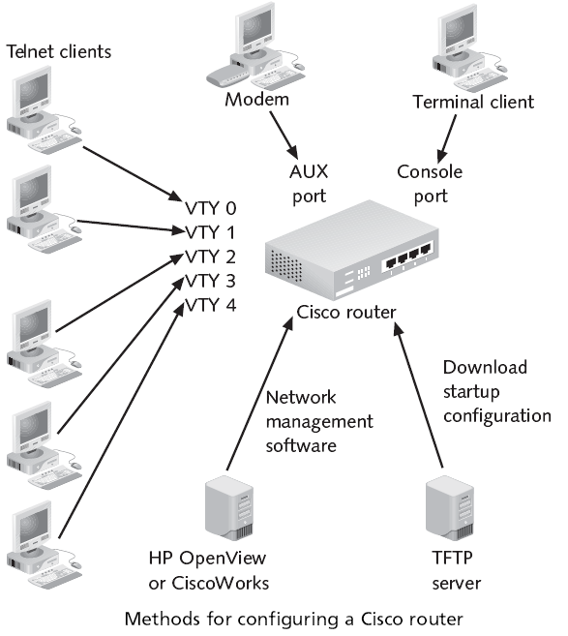
Configuration Sources
Router can be configured from:
Console port (A console session).
Auxiliary port (AUX) (A dialup connection using a modem).
Virtual terminals (VTY) (Telnet session to the router).
Trivial File Transfer Protocol (TFTP) server.

Slide 5
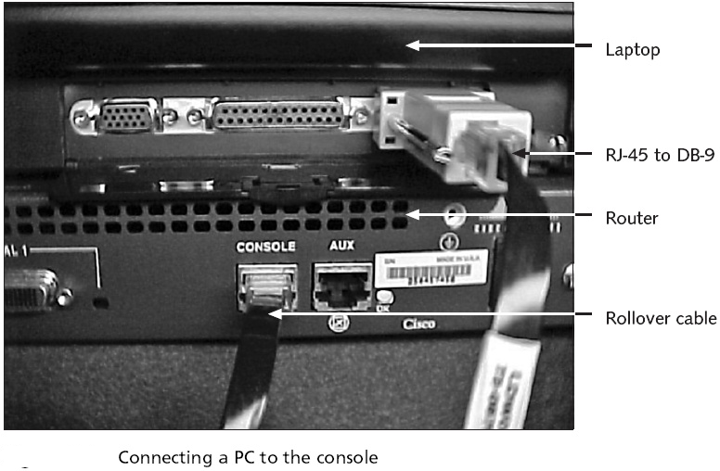
Configuration Sources

Slide 6
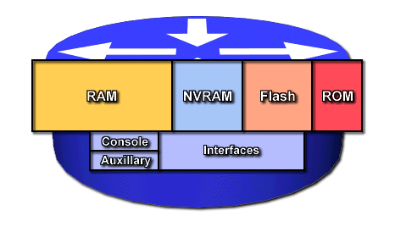
Router Components
RAM/DRAM
Routing tables.
ARP cache.
Packet buffering
Packet queues.
RAM contents lost when power is lost.
NVRAM – nonvolatile RAM
Router Configuration saved here
Configuration loaded from here on startup
NVRAM retains data when power is turned off.
Flash - erasable, reprogrammable ROM (EEPROM)
OS image & microcode.
Can have multiple copies of IOS.
Flash contents are retained when power is turned off.
ROM - read only memory.
POST (power on self test).
Bootstrap program (boots router and loads the IOS)
Operating system software.

Slide 7
Modes of the Router
Here are different modes of the router
• Setup Mode
• User Mode
• Privileged Mode
• Global Configuration Mode
• Interface Mode
‹#›

Slide 8
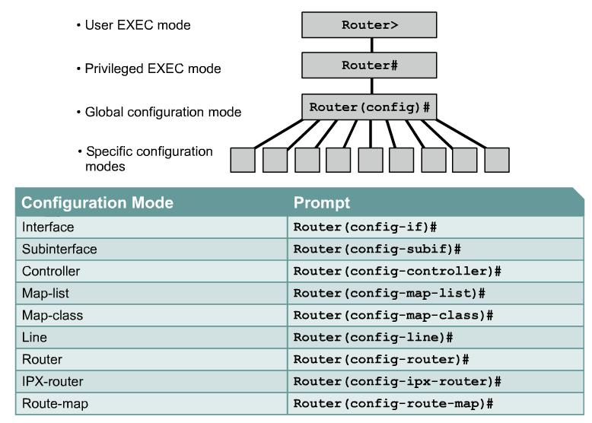
CLI command modes
Router> enable
Router# configure terminal
Router(config)# interface fa 0/0
Router(config-if)#

Slide 9
Cont..
User EXEC mode – allows the user to check the router status. No router configuration changes are allowed.
Privileged EXEC mode – allows the user to change the router configuration.
Global configuration mode – used to modify system wide configuration parameters .
Interface configuration mode – allows you to configure the Ethernet and serial interfaces on your router.
Line configuration mode – allows to configure the virtual terminals, console, and AUX lines that let us access the router.

Slide 10
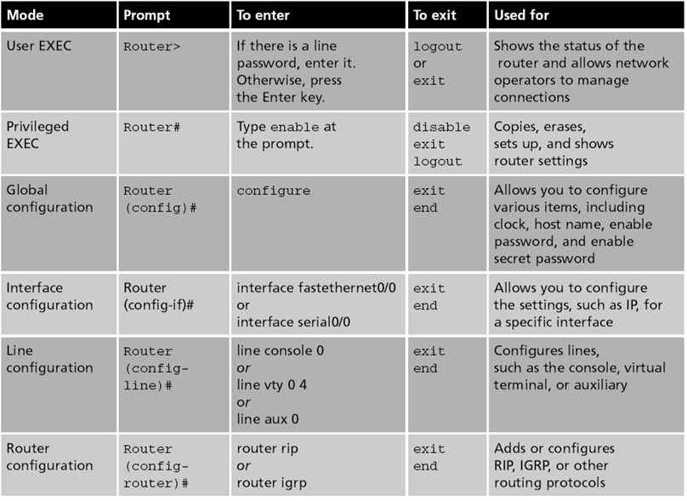

Slide 11
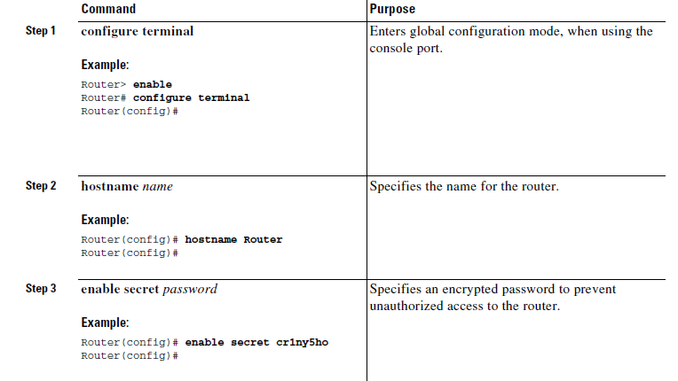
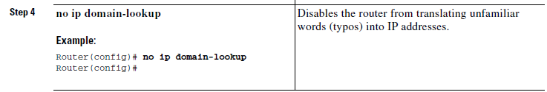
Configure Global Parameters

Slide 12
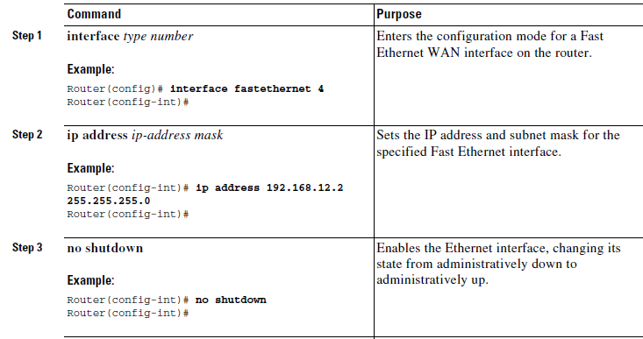
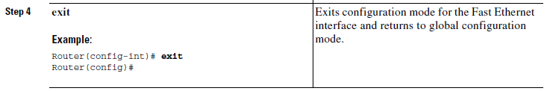
Configure the Fast Ethernet Interface

Slide 13
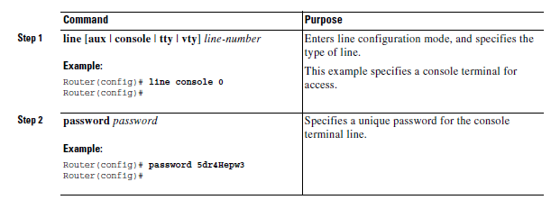
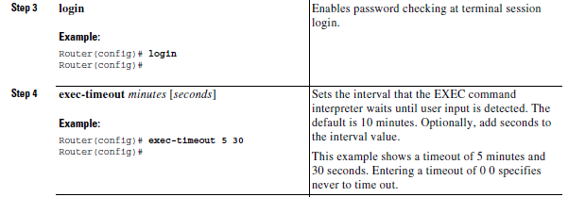
Configure Command-Line Access

Slide 14
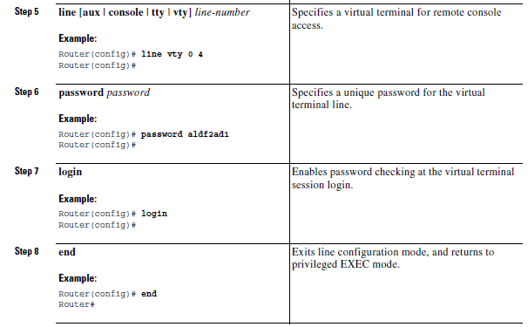
Configure Command-Line Access

Slide 15
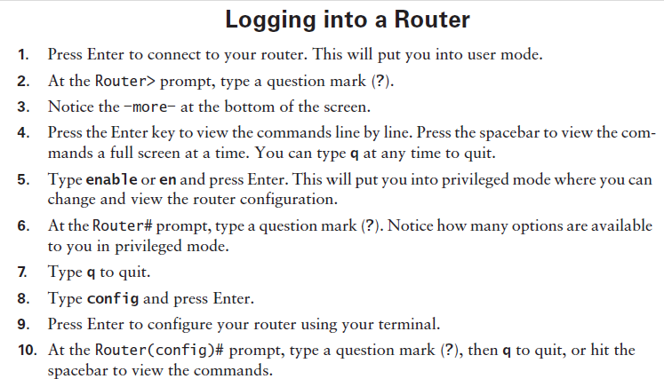

Slide 16
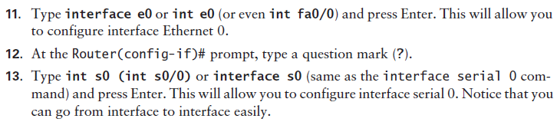
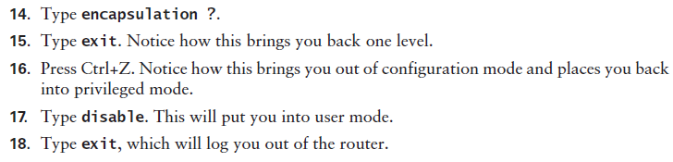

Slide 17
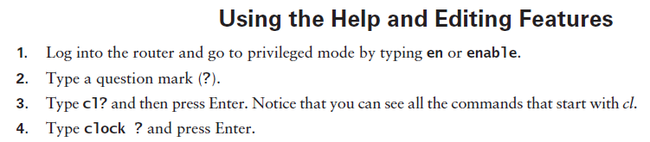
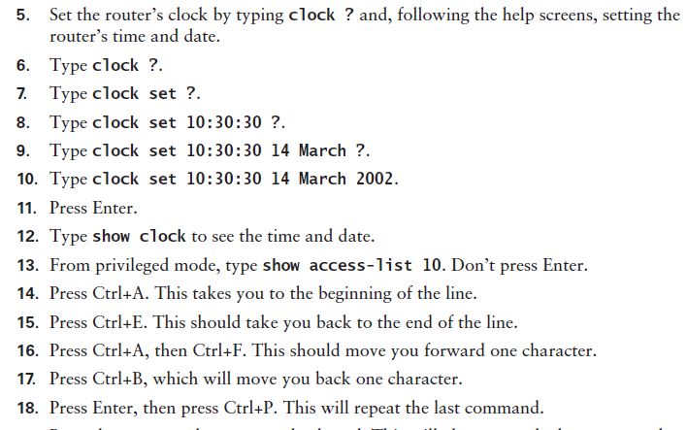

Slide 18


Slide 19
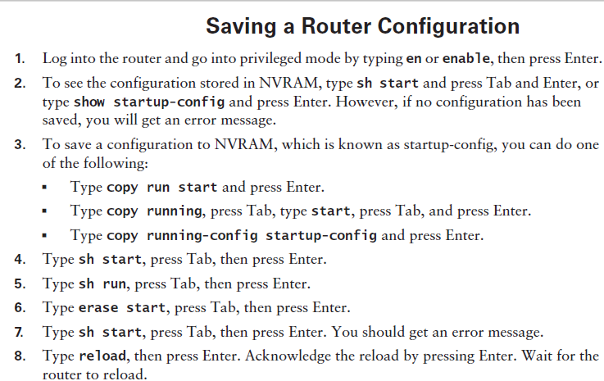

Slide 20
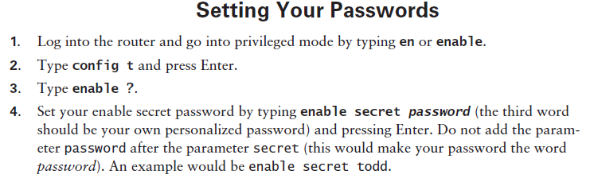
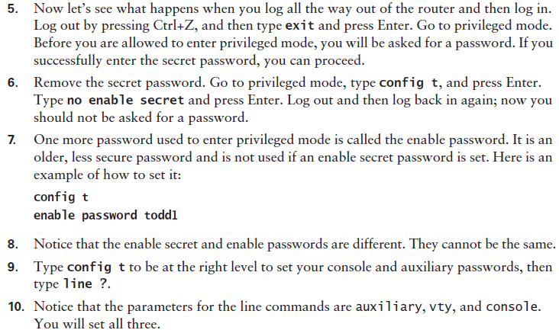

Slide 21
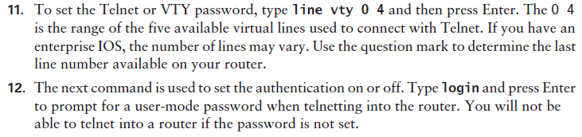
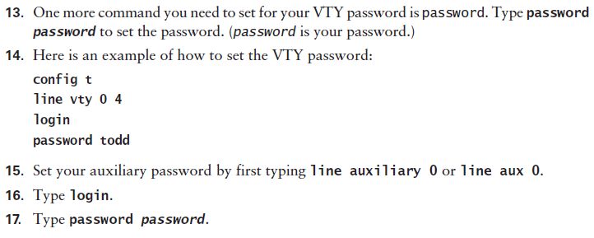

Slide 22
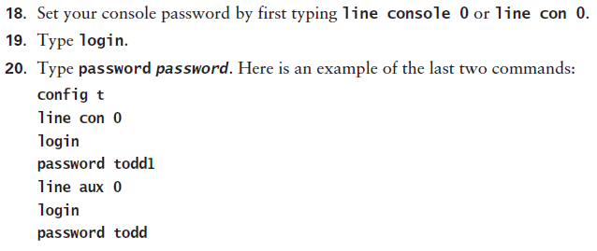
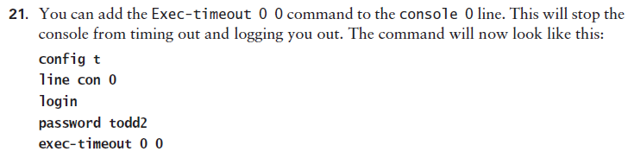

Slide 23
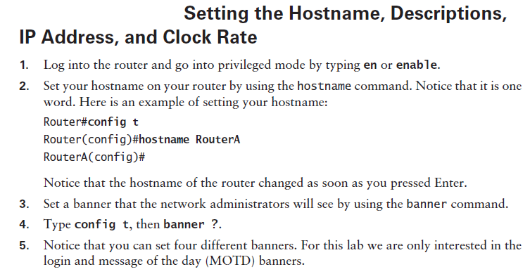

Slide 24
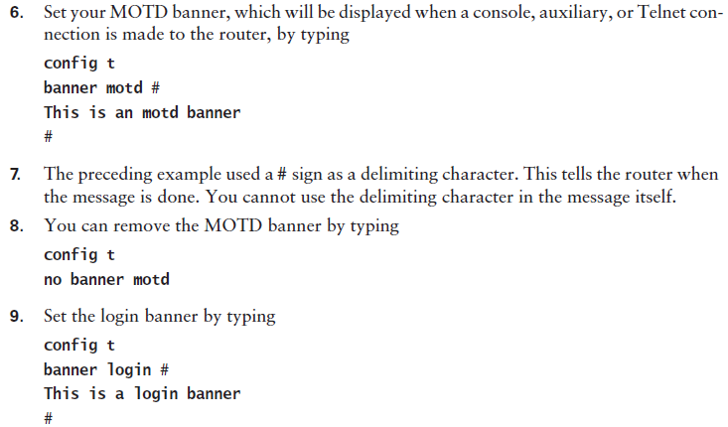

Slide 25
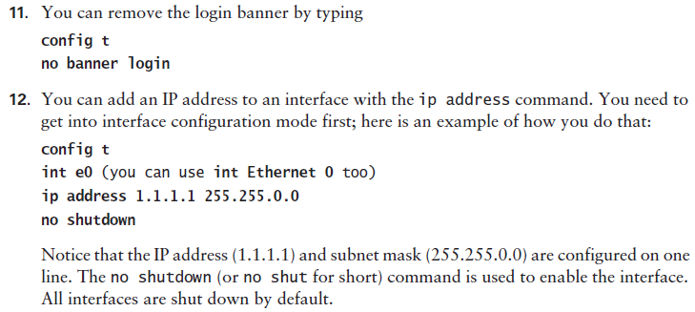
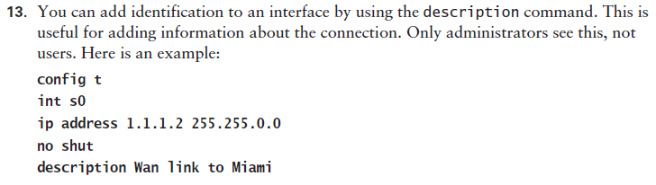

Slide 26
